Slide 1
Midway Capstone Presentation
Cristan Farmer

Slide 2
Assessment in Clinical Trials
PROBLEM
Scores compare an individual to others or themselves (i.e., change)
Need reliability (does it measure consistently?) and validity (does it measure what we think it measures?)
Inadequate measures impede ability to describe clinical phenomena and to determine efficacy of interventions

Slide 3
DASCA: Developmental Assessment of Social Communication Abilities R01 awarded to Somer Bishop, PhD (UCSF)
PROBLEM
Goal: Develop measure of social communication ability
Motivation: Available instruments focus on impairment; limited granularity at young ages and/or low developmental levels (e.g., low IQ)
Current question: How do specific social communication impairments predict overall social communication ability?
Notes:
Impairment and ability not exactly inverse; relationship between specific impairments and specific abilities unknown

Slide 4

DASCA Study Database
8,944 children with autism spectrum disorder aged 12 months to 18 years
DATA
VABS
Ability
Parent reported
Continuous summary score
ADOS
Impairments
Clinician observed
Ordinal item scores
ADI
Impairments
Interview
Ordinal item scores
SRS
Impairments
Parent reported
Ordinal item scores

Slide 5
Multiple runs of supervised learning
Classification is social communication ability category
Defined by factorial combinations of standard score or age equivalent, chronological age, sex
Features are specific social communication impairments
Items from ADOS, ADI, and SRS (n≈208)
APPROACH

Slide 6
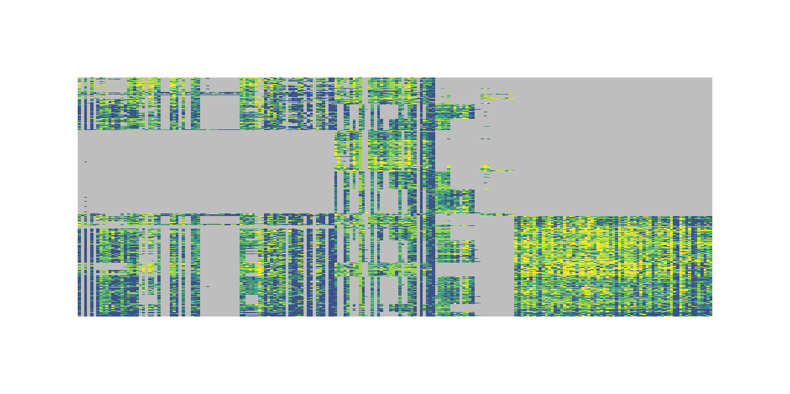
Messy, inconsistent data
Low score
High score
Missing data – battery depends on site
Missing data – item set depends on age
Repetition of items across scales
people
CHALLENGES
instruments
Notes:
Rows are children, columns are scales. First chunk is ADI, middle chunk is ADOS, last chunk is SRS

Slide 7
Orderly, organized Gantt chart
PLAN
We are here
End of class (?)

